Slide 1
This slide is hidden.
Insert the starting slides after this slide

Slide 2

Welcome to St Michael’s
23rd Sunday in Ordinary Time Year C
Please ensure all mobile phones are switched off.
Please be respectfully quiet as we prepare for our Celebration.
Notes:
Saturday 5.30PM First Sunday of Advent
7am - 7th Sunday in Ord Time Year B

Slide 3
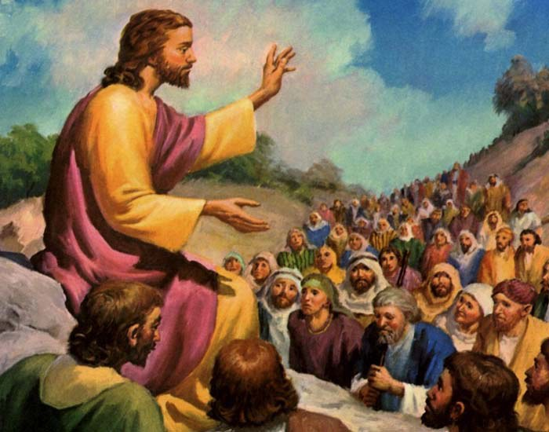
Great crowds accompanied Jesus …

Slide 4
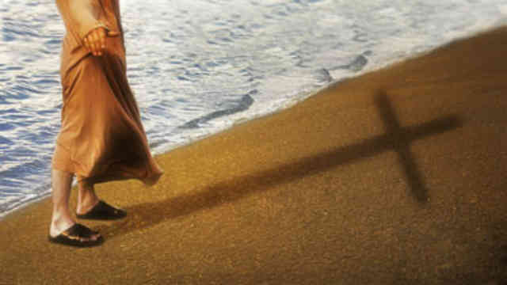
Jesus reminds them that to follow him involves a cost…

Slide 5
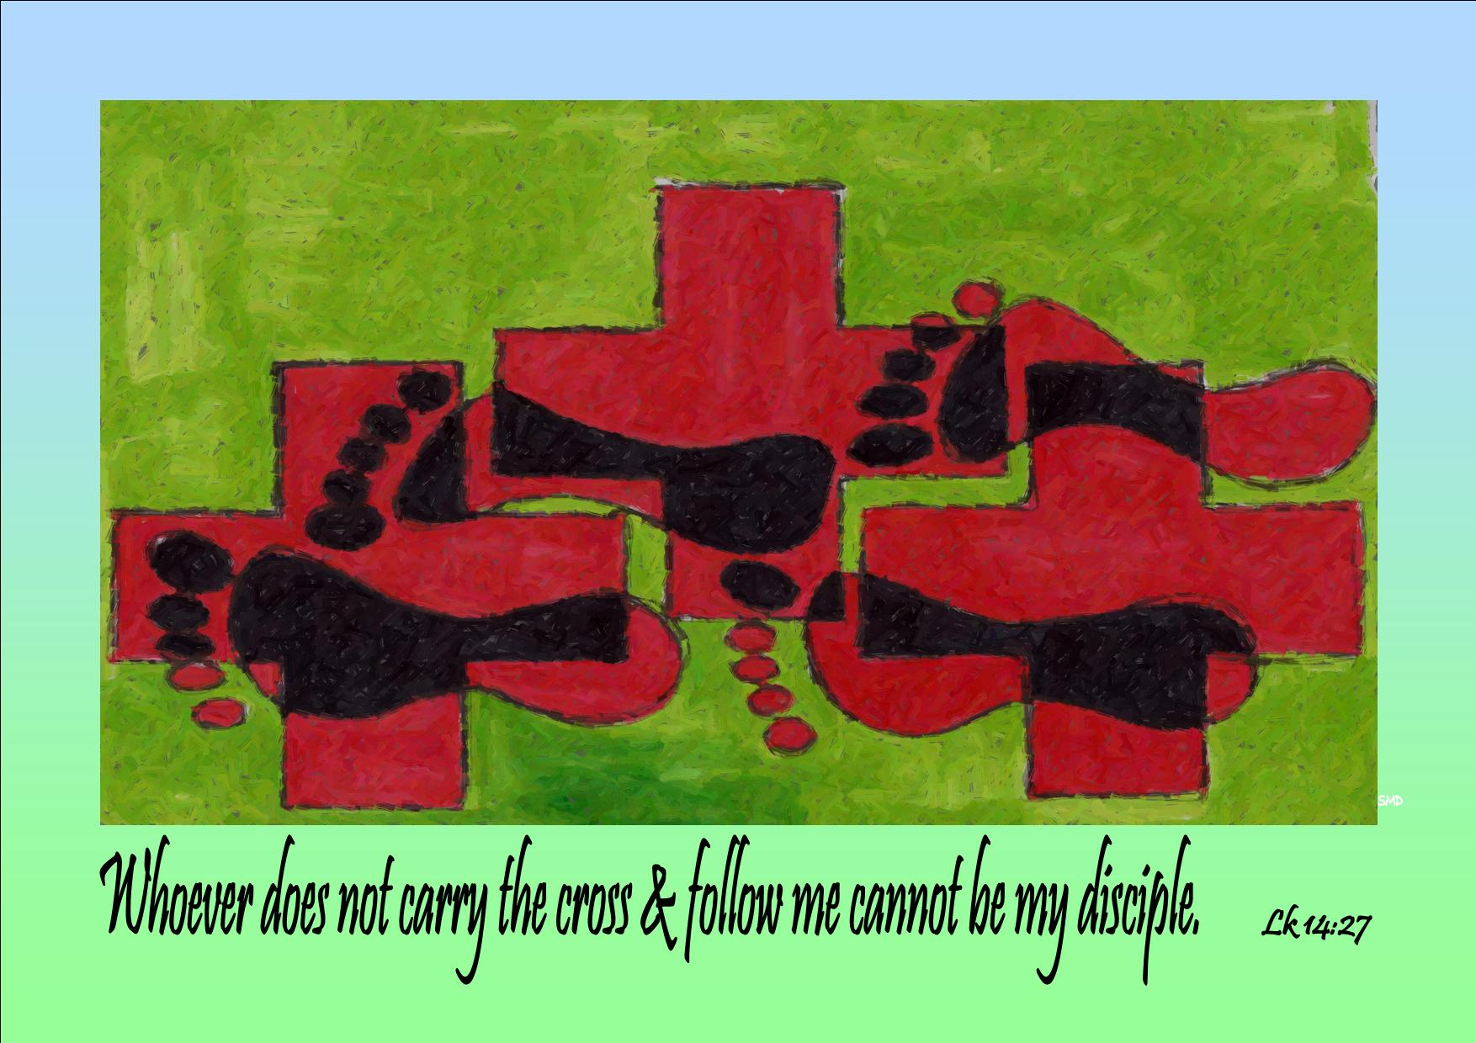
Anyone who does not carry his cross and come after me cannot be my disciple.

Slide 6
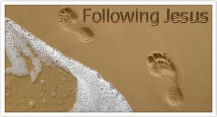
What does the call to follow Jesus cost you? What are some obstacles you have to cross?

Slide 7
Please Stand

Slide 8
This slide is hidden.
Insert the Entrance Hymn after this slide

Slide 9
Shout for joy
Shout for joy and sing
Your praises to the king
Lift your voice
And let your alleluias ring

Slide 10
Come before his throne
To worship and adore
Enter joyfully now
The presence of the Lord

Slide 11
You are my creator
You are my deliverer
You are my redeemer
You are Lord
And you are my healer

Slide 12
You are my provider
You are now my shepherd and my guide
Jesus Lord and king
I worship you

Slide 13
You are my creator
You are my deliverer
You are my redeemer
You are Lord
And you are my healer

Slide 14
You are my provider
You are now my shepherd and my guide
Jesus Lord and king
I worship you

Slide 16
Confiteor
I confess to almighty God
And to you, my brothers and sisters,
That I have greatly sinned
In my thoughts and in my words

Slide 17
In what I have done
And in what I have failed to do,
Through my fault,
Through my fault,
Through my most grievous fault;

Slide 18
Therefore I ask blessed Mary ever-Virgin,
All the Angels and Saints,
And you, my brothers and sisters,
To pray for me to the Lord our God.

Slide 20
Kyrie eleison
Kyrie eleison (2)
Christe eleison (2)
Kyrie eleison (2)

Slide 22
Gloria
Glory to God in the highest,
and on earth peace to people of good will.
We praise you, we bless you,
we adore you, we glorify you,

Slide 23
We give you thanks for your great glory,
Lord, God heavenly king,
O God, almighty father

Slide 24
Glory to God in the highest,
and on earth peace to people of good will.

Slide 25
Lord Jesus Christ, Only Begotten Son,
Lord God, Lamb of God, Son of the Father,
you take away the sins of the world,
have mercy on us;

Slide 26
you take away the sins of the world, receive our prayer;
you are seated at the right hand of the Father,
have mercy on us.

Slide 27
Glory to God in the highest,
and on earth peace to people of good will.

Slide 28
For you alone are the Holy One,
you alone are the Lord,
you alone are the Most High, Jesus Christ,
with the Holy Spirit,
in the glory of God the Father.

Slide 29
Glory to God in the highest,
and on earth peace to people of good will.
Amen.

Slide 31
Responsorial Psalm
In every age, O Lord,
you have been our refuge.

Slide 33
Alleluia
Alleluia, alleluia,
alleluia, alleluia

Slide 35
Apostles Creed
I believe in God,
the Father almighty,
Creator of heaven and earth,
and in Jesus Christ,
his only Son, our Lord,

Slide 36
(At the words that follow, up to and
including the Virgin Mary, all bow.)
who was conceived by the Holy Spirit,
born of the Virgin Mary,
suffered under Pontius Pilate,
was crucified, died and was buried;
he descended into hell;

Slide 37
on the third day he rose again from the dead;
he ascended into heaven,
and is seated at the right hand of God the Father almighty;

Slide 38
from there he will come to judge the living and the dead.
I believe in the Holy Spirit,
the holy catholic Church,

Slide 39
the communion of saints,
the forgiveness of sins,
the resurrection of the body,
and life everlasting.
Amen.

Slide 41
First Collection
This collection goes to the Bishop
for the support of the Diocese.
Thank you for your contribution

Slide 43
This slide is hidden.
Insert the Offertory Hymn after this slide.

Slide 44
Gifts for our Lord
Gifts for our Lord we bring to you now
With bread and with wine we will come
As in days long ago
When your word you did sow
We will reap the harvest of love

Slide 45
Gifts for our Lord, we bring to you now
Our hearts ever open to you
We will share with all friends
We will see you again
In the eyes of those who believe

Slide 46
With you by our side
Your love everlasting.
With you Jesus, Lord
We will start life anew

Slide 47
Gifts for our Lord we bring to you now
Our lives given freely to you
We will shed no more tears
We will end all our fears
Holdig hands and sharing your love

Slide 49
Priest: Pray my brothers and sisters,
that my sacrifice and yours may be
acceptable to God, the almighty Father.
All: May the Lord accept the sacrifice
at your hands for the praise and glory of his name, for our good and the good of all his holy Church.

Slide 50
Priest: The Lord be with you.
All: And with your spirit.
Priest: Lift up your hearts.
All: We lift them up to the Lord.

Slide 51
Priest: Let us give thanks to the
Lord our God.
All: It is right and just.

Slide 53
Holy
Holy, Holy, Holy Lord God of hosts,
Heaven and earth are full of your glory. Hosanna in the highest
Blessed is he who comes
in the name of Lord,
Hosanna in the highest.

Slide 55
Memorial acclamation
Save us saviour of the world,
For by your cross and resurrection,
You have set us free

Slide 56
Memorial acclamation
When we eat this bread
And drink this cup
We proclaim your death O Lord
Until you come again

Slide 57
Memorial acclamation
We proclaim your death O Lord
And profess your resurrection
Until you come again

Slide 59
Amen
Amen, amen, amen, amen.
Amen, amen, amen, amen.

Slide 61
Priest: The Lord be with you.
All: And with your spirit

Slide 63
Peace
May the peace of the Lord be with you
With your friends and your family too
Let it be, let it grow
And everywhere you go
May the peace of the Lord follow you

Slide 64
Lamb of God
Lamb of God, lamb of God
You take away the sins of the world
Have mercy on us, lamb of God

Slide 65
Lamb of God, lamb of God
You take away the sins of the world
Have mercy on us, lamb of God

Slide 66
Lamb of God, lamb of God
You take away the sins of the world
Grant us, grant us peace

Slide 68
All: Lord, I am not worthy
that you should enter under my roof,
but only say the word
and my soul shall be healed.

Slide 70
Priest: Behold the Lamb of God, behold him
who takes away the sins of the world.
Blessed are those called to the supper of the Lamb.
All: Lord, I am not worthy
that you should enter under my roof,
but only say the word
and my soul shall be healed.

Slide 71
This slide is hidden.
Insert the Communion Hymns after this slide.

Slide 72
Panis Angelicus
Panis angelicus
Fit panis hominum
Dat panis coelicus
Figuris terminum

Slide 73
O res mirabilis
Man ducat Dominum
Pauper, pauper
Servus et humilis

Slide 74
Pauper, pauper
Servus et humilis

Slide 75
Panis angelicus
Fit panis hominum
Dat panis coelicus
Figuris terminum

Slide 76
O res mirabilis
Man ducat Dominum
Pauper, pauper
Servus et humilis

Slide 77
Pauper, pauper
Servus, servus et humilis

Slide 78
Ave Maria
Ave Maria, gratia plena
Dominus tecum,
Ave Maria

Slide 79
Benedicta tu
Benedicta tu in mulieribus
Et benedictus
Fructus ventris tui Jesus

Slide 80
Ave Maria,
Ave Maria

Slide 81
Santa Maria
Mater dei
Ora pro nobis peccatoribus

Slide 82
Nunc et in hora
Mortis nostrae amen

Slide 83
Ave Maria
Ave Maria
Ave

Slide 84
Hail Mary
Hail Mary, full of grace
The Lord is with you
Blessed are you among women
And blessed is the fruit of your womb
Jesus

Slide 85
Holy Mary, mother of God
Pray for us sinners now
And at the hour of our death
Amen

Slide 86
Gentle woman, quiet light
Morning star, so soft and bright
Gentle mother, peaceful dove
Teach us wisdom, teach us love

Slide 87
You were chosen by the Father
You were chosen for the Son
You were chosen from all women
And for woman, a shining one

Slide 88
Gentle woman, quiet light
Morning star, so soft and bright
Gentle mother, peaceful dove
Teach us wisdom, teach us love

Slide 89
Blessed are you among women
Blessed in turn all women too
Blessed they, with peace full spirits
Blessed they with gentle hearts

Slide 90
Gentle woman, quiet light
Morning star, so soft and bright
Gentle mother, peaceful dove
Teach us wisdom, teach us love
Teach us wisdom, teach us love

Slide 92
Second Collection
What you contribute now
is for the support of our
parish and its mission.
Thank you for your generosity

Slide 93
This slide is hidden.
Insert the Notices for the week after this slide

Slide 94

The SVDP pantry needs to restock the following items:
  2 min noodles;
  biscuits;
  longlife milk;
  cereal;
  baked beans.
Many thanks for your support

Slide 95
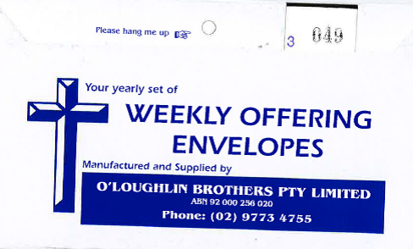
If you have not collected your envelopes please collect them today!

Slide 96

Pope Francis has invited us to pray for peace.
There is a prayer you might like to use during the coming week in the bulletin.

Slide 97

Please take home your bulletins or download it from
www.stmichaelsparish.com
  www.facebook.com/
  blacktowncatholics

Slide 98
This slide is hidden.
The next slide can be used for videos.
Insert the video into the slide.

Slide 100
Priest: The Lord be with you.
All: And with your spirit.

Slide 102
This slide is hidden.
Insert the Recessional Hymns after this slide.

Slide 103
Our Lady of the Southern Cross
You said your ‘yes’ to the angel’s word
The spirit of God was with you
You walked with jesus throughout his life,
With a mother’s care and trust
You stood at last beneath the cross
A model of courage and strength

Slide 104
Teach us to hope,
to believe and love like you,
Our lady of the southern cross.
Shine upon us,
Guide us through life

Slide 105
Show us the way to Christ your son
Shine upon us guide us through life,
Mother of Jesus mother of Christ.

Slide 106
You sat and prayed with his closest friends
Awaiting the spirit to come.
You saw them change as they went transformed
To a world they hardly knew.
Now stand with us, O mother of light,
As we speak God’s love and truth

Slide 107
Teach us to hope,
to believe and love like you,
Our lady of the southern cross.
Shine upon us,
Guide us through life

Slide 108
Show us the way to Christ your son
Shine upon us guide us through life,
Mother of Jesus mother of Christ.
Mother of Jesus, mother of Christ.

Slide 110
This slide is hidden.
Insert the final slide here.

Slide 111
What does the call to follow Jesus cost you? What are some obstacles you have to cross?

